Slide 1







Slide 2


English Writing I
CQUPT
SCHOOL OF FOREIGN LANGUAGES
英语写作1
www.cqupt.edu.cn

Slide 3
English Writing I
CQUPT
SCHOOL OF FOREIGN LANGUAGES
Week 6
www.cqupt.edu.cn

Slide 4
CQUPT
SCHOOL OF FOREIGN LANGUAGES
Chapter 5
The Fourth Step in Essay Writing
www.cqupt.edu.cn

Slide 5
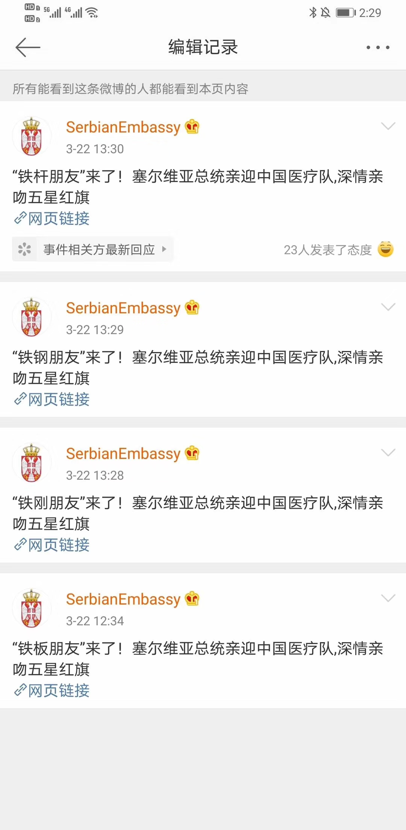

Slide 6
Effective Sentences

Slide 7
Step 4 Revise and Edit Your Work
Use parallelism.
Use a consistent point of view.
Use specific words.
Use active verbs.
Use concise words.
Use varied sentences.
Notes:
There are seveal strategies, and the textbook illustrate them in details.
Today, I won't cover every one of them, just something important, and something extension.

Slide 8
Unity
Faulty:
Born in a small town in South China in the early 1950s, he grew up to be a famous musician.
Revised:
He was born in a small town in South China in early 1950s. In is childhood he liked to sing songs. Laterhe entered a conservatory. In the 1970s he became a famous musician.

Slide 9
Unity
Faulty:
Du Fu was one of the greatest poets.
Revised:
Du Fu was one of the greatest poets of the Tang period.

Slide 10
Coherence
Faulty:
A man is judged not only by what he says but also by his deeds.
Revised:
A man is judged not only by what he says but also by what he does. A man is judged not only by his words but also by his deeds.

Slide 11
Coherence
Faulty:
We thought she was charming, intelligent, and a very capable young woman.
Revised:
We thought she was charming, intelligent, and very capable. We thought she was a charming, intelligent, and very capable young woman.

Slide 12
Coherence
Faulty:
We have great faith and high hopes for her.
Revised:
We have great faith in and high hopes for her.

Slide 13
Coherence
Faulty:
She told my sister that she was wrong.
Revised:
“I'm wrong,” she said to my sister.
She admitted that she was wrong and said so to my sister.
“You're wrong,” she said to my sister.
My sister was told that she was wrong.

Slide 14
Coherence
Faulty:
An important thing for the student to remember is that when writing a paper, you should not plagiarize.
Revised:
An important thing for the student to remember is that when writing a paper, he/she should not plagiarize.
An important thing for students to remember is that when writing a paper, they should not plagiarize.

Slide 15
Coherence
Faulty:
Those who wish to take Linguistics are expected to sign his name on this sheet of paper.
Revised:
Those who wish to take Linguistics are expected to sign their names on this sheet of paper.

Slide 16
Coherence
Faulty:
She reviewed the lesson taught last week and all the exercises assigned by the teacher was done.
Revised:
She reviewed the lesson taught last week and did all the exercieses assigned by the teacher.

Slide 17
Conciseness
Wordy:
It was blue in colour.
Concise:
It was blue.

Slide 18
Conciseness
Wordy:
It was small in size.
Mary is a quiet and careful woman.
He returned in the early part of the month of August.
Concise:
It was small.
Mary is quiet and careful.
He returned in early August.

Slide 19
Conciseness
Wordy:
He gave me many reasons for the failure, but the reasons he gave were not convincing.
Concise:
He gave me many reasons for the failure, but none of them was convincing.

Slide 20
Conciseness
Wordy:
In my opinion, I think your plan is feasible.
Concise:
In my opinion, your plan is feasible.
I think your plan is feasible.

Slide 21
Conciseness
Wordy:
There was a pine tree that stood like a giant on the top of the mountain. It towered over the tree around it.
Concise:
The pine tree on the top of the mountain stood like a giant and towered over the tree around it.
The giant pine tree on the top of the mountian towered over the trees around it.
On the top of the mountain was a giant pine tree which towered over the trees around it.

Slide 22
Conciseness
Wordy:
Mr. Smith usually likes to drink all kinds of wines that are produced in Frace.
Concise:
Mr. Smith prefers wined produced in France.
Mr. Smith prefers French wines.

Slide 23
Effective Sentences
Unity
Coherence
Conciseness

Slide 24
To Do List
完成教材Chapter 5的学习
并完成教材上 p. 130-132 的Review Test 2, 3, 4
submission: QQ Group - Homework

Slide 25
Homework (DDL: 2020/04/05 Sunday 12:00noon)
Finish your essay about the following topic:
E-learning or Classroom - Which Is Better?
Submission: 批改网
作文号：1614135
字数：＞150

Slide 26
CQUPT
SCHOOL OF FOREIGN LANGUAGES
Thank you！
www.cqupt.edu.cn

